Slide 1

Sociodemographic Data and COVID-19 Vaccine Hesitancy in the US
Capstone Project - Data Analytics & Web Visualization - University of Toronto SCS
Hayden Chen
Tiffany Lai
Aarani Sivasekaram
Amy Talbot
Due: June 9th 2021
Notes:
Hi everyone, our team consisted of Hayden, Tiffany, Aarani and Amy.
We explored sociodemographic indicators and their influences on vaccine hesitancy through machine learning.
We’ll walk you through our presentation now and we are happy to take questions at the end.

Slide 2
Presentation Overview
Topic selection and rationale
Description of data source
Proposed analysis questions
Data exploration
Analysis and data visualizations
Conclusion, lessons learned and next steps
Notes:
As an outline for our presentation, we plan to walk you through [read slide].

Slide 3
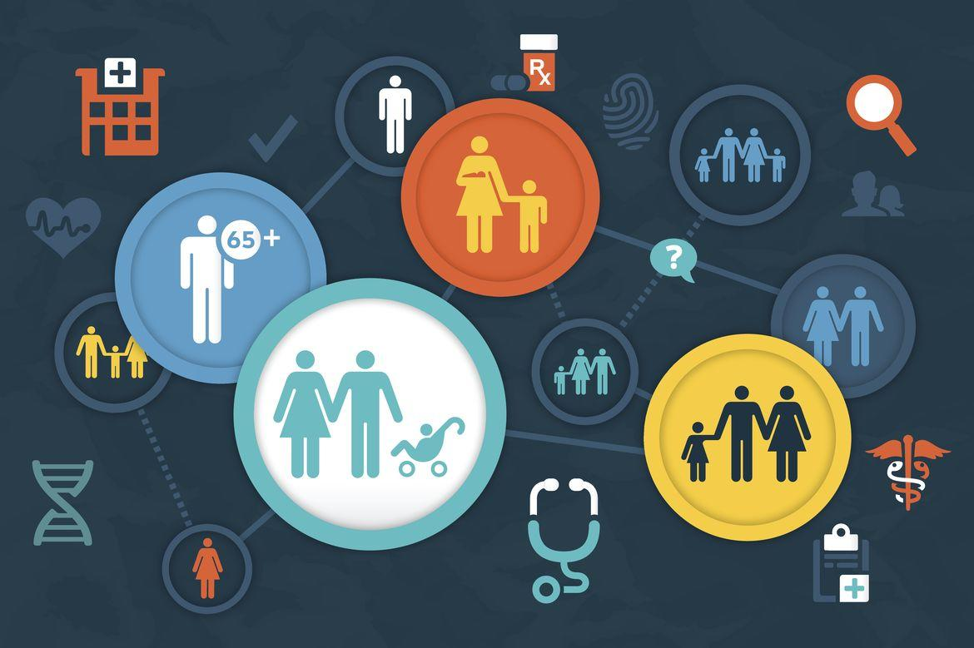
Topic Selection and Rationale
Topic: Sociodemographic data and COVID-19 vaccine hesitancy in the United States (US).
Rationale: Given the global presence of COVID-19 and the implementation of vaccines in recent months. Our team decided to look into vaccine hesitancy to understand this issue better.
Notes:
Our selected topic is sociodemographic data and COVID-19 vaccine hesitancy in the United States.
Given the global presence of COVID-19 and the implementation of vaccines in recent months. Our team decided to look into vaccine hesitancy to understand this issue better.
Research suggests COVID-19 has disproportionately affected priority populations greater, and our team was interested in determining correlations between vaccine hesitancy and sociodemographic data.
Socio-demographic variables include, for example: age, sex, ethnicity, education, employment and income.

Slide 4
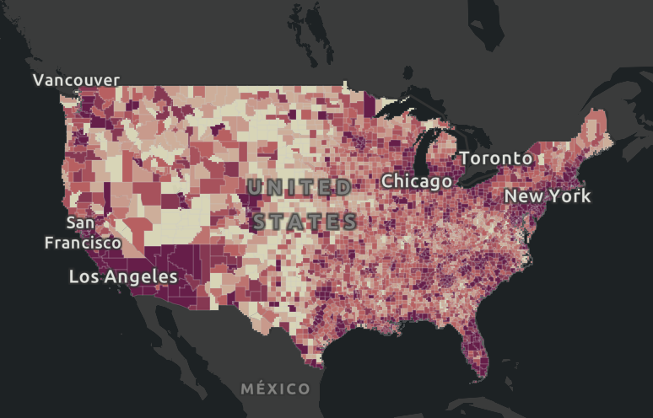
Description of Data Source
Our team secured a dataset from Kaggle that captures US county-level data that includes:
Sociodemographic data,
Vaccine implementation indicators,
Geographic data, and
Percentage of each county populations that is estimated to be vaccine hesitant (2).
The dataset contained information from 3,142 counties in the US.
Heat map of COVID-19 cases in the US - John Hopkins Coronavirus Resource Center
Notes:
Our team secured a dataset from Kaggle that captures US county-level data.
This Kaggle data was sourced from data.gov an open-source US data platform.
The dataset is broken down into sociodemographics of the counties - represented by % of population that are: Hispanic, Black, Asian, White, Indigenous Americans/Indigenous Alaskans, Hawaiian/Pacific Islander
The CDC's Social Vulnerability Index (SVI) summarizes the extent to which a community is socially vulnerable to disaster. SVI values range from 0 (least vulnerable) to 1 (most vulnerable).
Vaccine implementation indicators include: CVAC level of concern - which measures the level of concern for a difficult rollout on a range from 0 (lowest concern) to 1 (highest concern).
Our outcomes of interest was the % of population that was estimated to be vaccine hesitant and the % of population that was estimated to be strongly vaccine hesitant.
Overall our dataset contained information from 3,142 counties in the US.

Slide 5
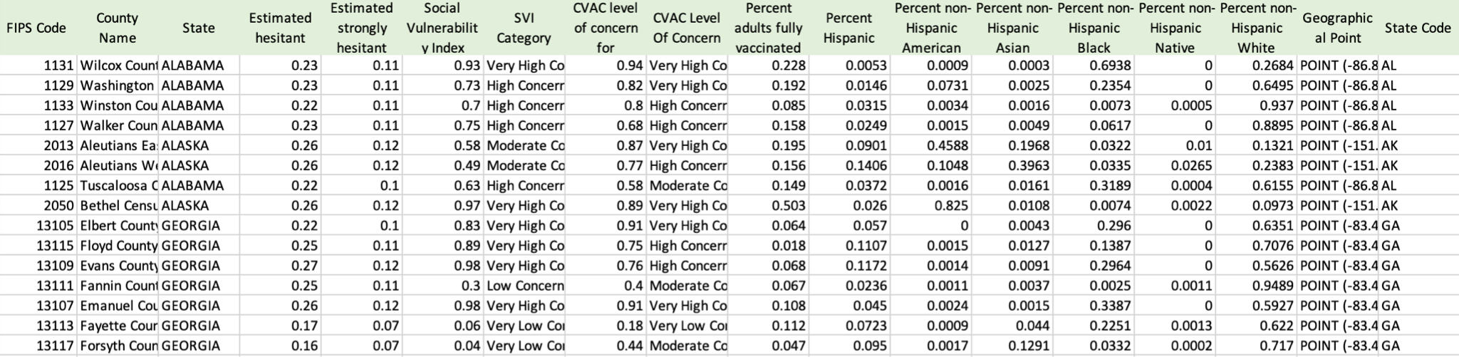
Description of Data Source
Our team secured a dataset from Kaggle that captures US county-level data broken down into: sociodemographics, vaccine implementation indicators and the percentage of the the population that is estimated to be vaccine hesitant.
Notes:
Our team secured a dataset from Kaggle that captures US county-level data.
This Kaggle data was sourced from data.gov an open-source US data platform.
The dataset is broken down into sociodemographics of the counties - represented by % of population that are: Hispanic, Black, Asian, White, Indigenous Americans/Indigenous Alaskans, Hawaiian/Pacific Islander
The CDC's Social Vulnerability Index (SVI) summarizes the extent to which a community is socially vulnerable to disaster. SVI values range from 0 (least vulnerable) to 1 (most vulnerable).
Vaccine implementation indicators include: CVAC level of concern - which measures the level of concern for a difficult rollout on a range from 0 (lowest concern) to 1 (highest concern).
Our outcomes of interest was the % of population that was estimated to be vaccine hesitant and the % of population that was estimated to be strongly vaccine hesitant.
Overall our dataset contained information from 3,142 counties in the US.

Slide 6
Proposed Data and Analysis Questions
Predict | Impacts | Analysis | Extrapolate
Based on the sociodemographic indicators available, are we able to predict vaccine hesitancy in US counties? | How do sociodemographic indicators affect vaccine hesitancy? | What barriers exist in vaccine implementation and how can these be mitigated? | How can this analysis inform vaccine implementation strategies within an Ontario context?

Slide 7
Data Exploration
Data Preprocessing
Our team filtered our dataset based on columns of interest, several columns with geographical information were dropped to isolate sociodemographic feature columns of interest.
We identified our target column of interest as the percentage of population vaccine hesitant.
Null values were identified and replaced with zeros (0).
Our cleaned dataset had nine (9) columns and 3,142 rows and was uploaded into our SQL database.
Notes:
Description of preliminary data preprocessing: The merged dataset was used for the data preprocessing in preparation for the machine learning models. Unnecessary feature columns were dropped. Remaining feature columns only had 1 row found to have a null value which was filled with 0. The clean dataset was then connected with the database.
Description of preliminary feature engineering and preliminary feature selection, including the decision-making process: In the original dataset, two target outcomes were available: percent of population vaccine hesitant and percent of population strongly vaccine hesitant. Only one target outcome was chosen, percent vaccine hesitant, as it is unclear how the data/survey distinguished the difference between estimated vaccine hesitancy and estimated strong vaccine hesitancy. In the decision-making process for features, all columns with irrelevant/redundant data was removed. For example, the 'svi_category'(object) was a redundant column as the 'social_vulnerability_index'(float64) was available to use as a feature to train and test the models.

Slide 8
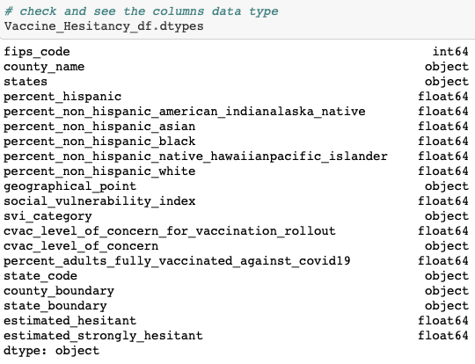
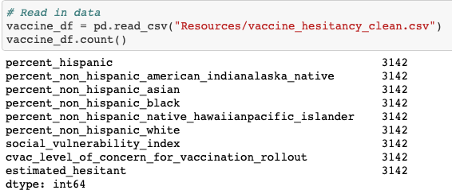
Data Exploration
Notes:
Data Preprocessing
Our team filtered our dataset based on columns of interest, several columns with geographical information were dropped to isolate sociodemographic feature columns of interest.
We identified our target column of interest as the percentage of population vaccine hesitant.
Null values were identified and replaced with zeros (0).
Our cleaned dataset had nine (9) columns and 3,142 rows and was uploaded into our SQL database

Slide 9
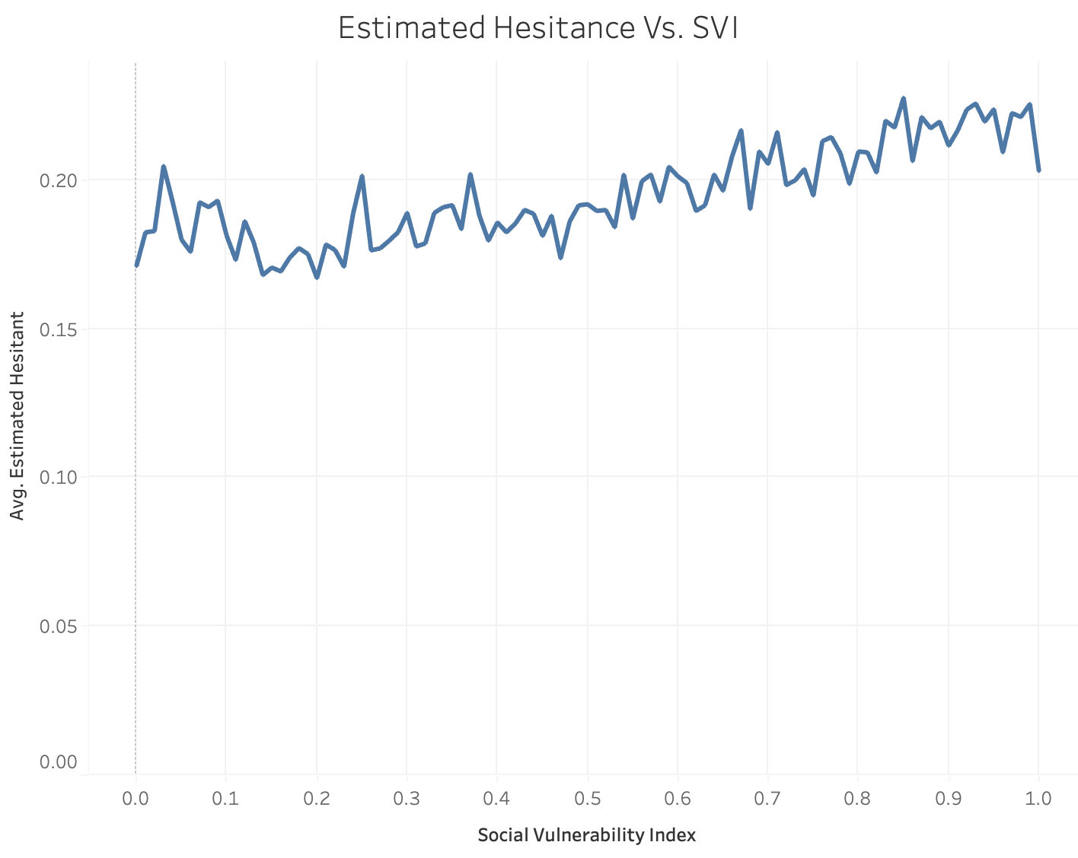
Data Visualizations
Average Percentage of Population Vaccine Hesitant by Social Vulnerability Index (per County)
Notes:
Increasing trend seen in % population vaccine hesitant by SVI line graph

Slide 10
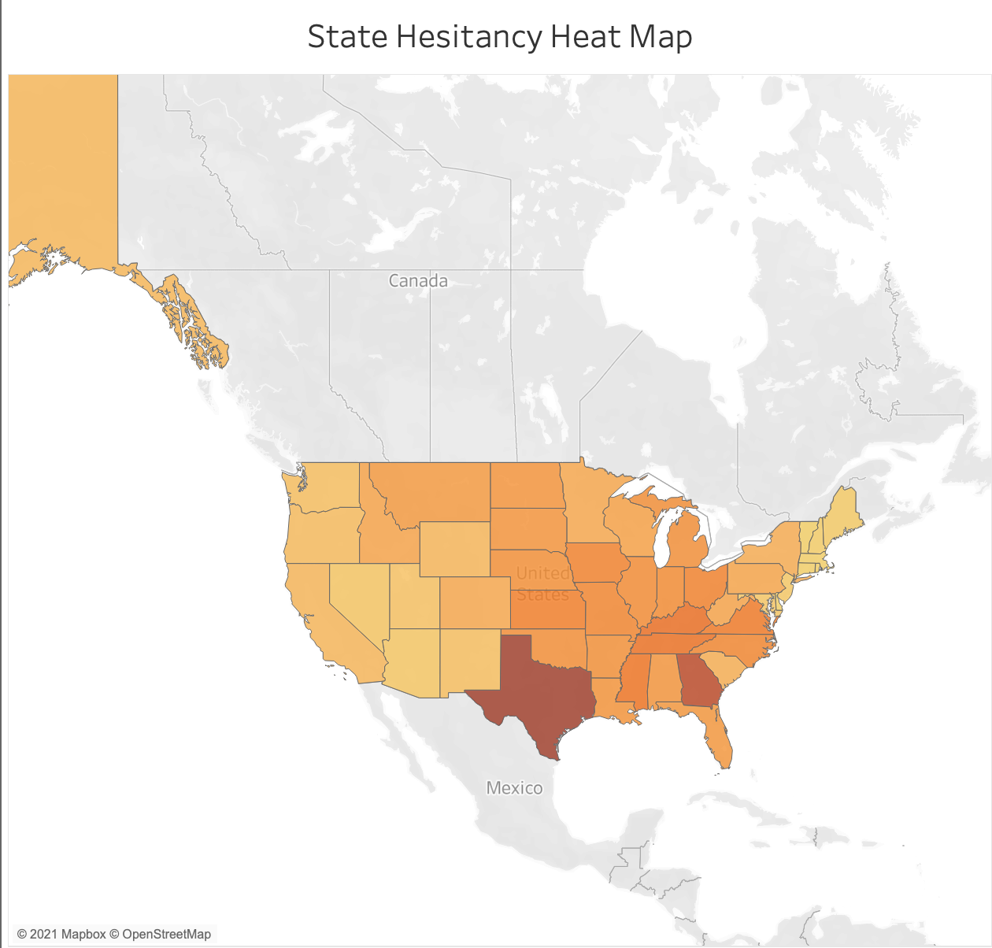
Data Visualizations
https://public.tableau.com/views/Vaccine_Hesitancy_Project/Story1?:language=en-US&:display_count=n&:origin=viz_share_link
Notes:
Discuss heatmap of % population vaccine hesitant
https://public.tableau.com/views/Vaccine_Hesitancy_Project/Story1?:language=en-US&:display_count=n&:origin=viz_share_link

Slide 11
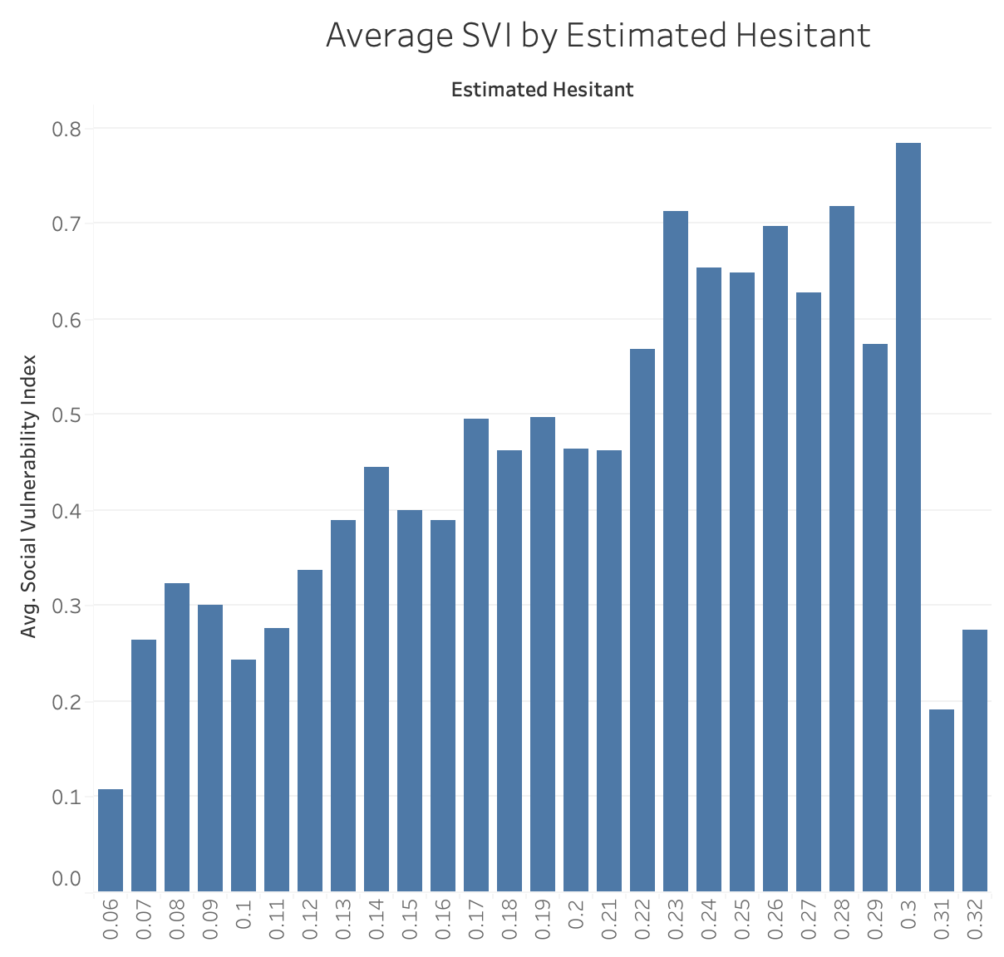
Data Visualizations
Average Social Vulnerability Index (per County) by Percentage of Population Vaccine Hesitant
Notes:
Increasing trend seen in SVI by % population vaccine hesitant bar graph

Slide 12
Data Analysis
We chose to use supervised machine learning linear regression models as our dataset has a continuous target outcome that could be used for the model predictions within the numeric range of 0-1.
Linear Regression - Model Selection
Linear regression models were used to predict the potential effects of sociodemographic indicators on vaccine hesitancy.
A simple linear regression was used first to test if the data is linear or non-linear.
The results of the linear regression model indicated a more complex model should be used as the predictions were not very close to the original targets.
Notes:
Linear regression was the first model used to predict the potential effects of sociodemographic indicators on vaccine hesitancy. It is beneficial as it is a fast and efficient model for initial machine learning analysis. A simple linear regression was used first to test if the data is linear or non-linear. The results of the linear regression model indicated a more complex model should be used as the predictions were not very close to the original targets. The major limitation of linear regression model is non-linear data.

Slide 13
Data Analysis
We chose to use supervised machine learning linear regression models as our dataset has a continuous target outcome that could be used for the model predictions within the numeric range of 0-1.
Linear Regression - Model Selection
Linear regression models were used to predict the potential effects of sociodemographic indicators on vaccine hesitancy.
A simple linear regression was used first to test if the data is linear or non-linear.
The results of the linear regression model indicated a more complex model should be used as the predictions were not very close to the original targets.
Notes:
Linear regression was the first model used to predict the potential effects of sociodemographic indicators on vaccine hesitancy. It is beneficial as it is a fast and efficient model for initial machine learning analysis. A simple linear regression was used first to test if the data is linear or non-linear. The results of the linear regression model indicated a more complex model should be used as the predictions were not very close to the original targets. The major limitation of linear regression model is non-linear data.

Slide 14
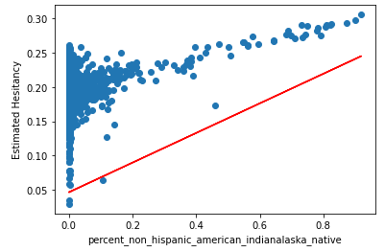
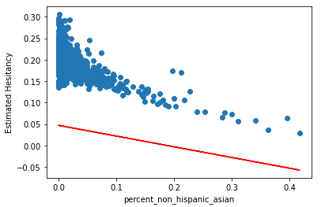
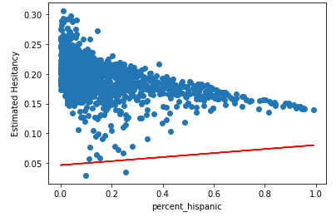
Data Analysis
Linear Regression - Outputs
Regression metrics:
R Squared Score: 0.309
Explained Variance Score: 309
Notes:
A few examples of regression analysis using selected features - positive, negative, and fairly static relationships.
Regression Metrics:
Mean Absolute Error
Mean Squared Error
R Squared Score
Explained Variance Score
R-squared (R2), which is the proportion of variation in the outcome that is explained by the predictor variables. In multiple regression models, R2 corresponds to the squared correlation between the observed outcome values and the predicted values by the model. The higher the R-squared, the better the model.

Slide 15
Data Analysis
Random Forest Regression - Model Selection
This model was used to compare the efficiency and efficacy of the predictions to the linear regression model.
The random forest model was able to intake all feature columns to build several simple decision trees to predict the percent vaccine hesitancy.
Overall the machine learning model was more effective in approximating real-world data points and we would recommend this model if using a similar dataset.
Regression metrics:
R Squared Score: 0.437
Explained Variance Score: 438
Notes:
Description of how data was split into training and testing sets: For the random forest regression model, the training set used 70% of the data and the testing set used the remaining 30% of the data.
The random forest model is beneficial in this analysis as it can input multiple features in a fast and powerful algorithm which is not prone to overfitting. However, random forest is limited as all predictions are within the training set and it is unable to extrapolate values which are not within the dataset.

Slide 16
Conclusion
Predict | Impacts | Analysis | Extrapolate
Based on the sociodemographic indicators available, are we able to predict vaccine hesitancy in US counties? | How do sociodemographic indicators affect vaccine hesitancy? | What barriers exist in vaccine implementation and how can these be mitigated? | How can this analysis inform vaccine implementation strategies within an Ontario context?

Slide 17
Technologies and Tools Used in this Project

Slide 18
Conclusion
Inferences
Our linear regression models suggest some sociodemographic features were more impactful than others in predicting vaccine hesitancy, however our data was not always linear.
The random forest regression machine learning model was overall more accurate in predicting values, however our R squared value of 43% suggests that the outcome of vaccine hesitancy is only moderately explained by the feature values in our dataset.

Slide 19
Lessons Learned and Next Steps
Ontario Context
With an emphasis on collecting sociodemographic data in public health, future exploration of vaccine hesitancy with a more robust dataset would be beneficial.

Slide 20
Thank you for listening!
Any questions?

